Slide 1


Simulating a data center with a sharing System using a virtualization technique
Abhishek Kumar
(Supervisor: Elham Hojati)
May 10, 2018

Slide 2
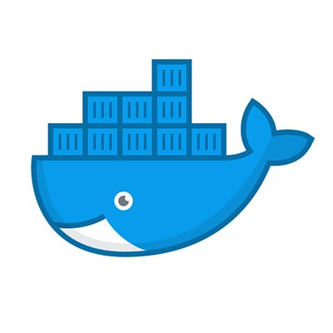
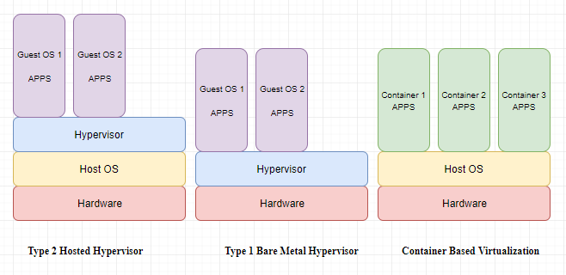
Virtualization Techniques
Extending an existing interface to replicate the behavior.
A component within cloud computing.
Separates the operating system from the underlying hardware.
Hypervisor: a software allowing the abstraction from the hardware.
Containers virtualize at operating system level.
Each container shares the same kernel and most of the base operating system.
Containers are smaller and light weight.

Slide 3
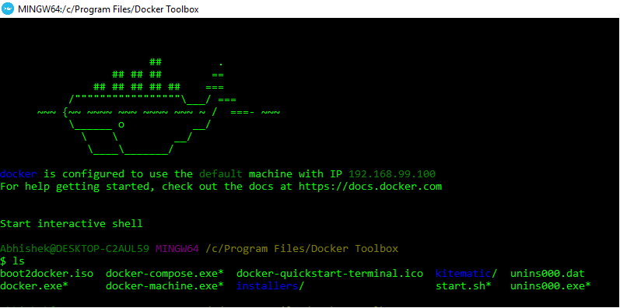
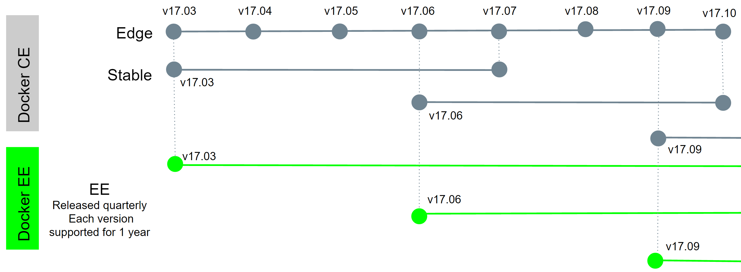
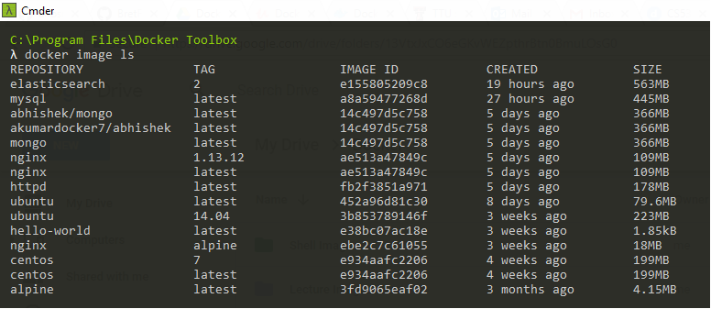
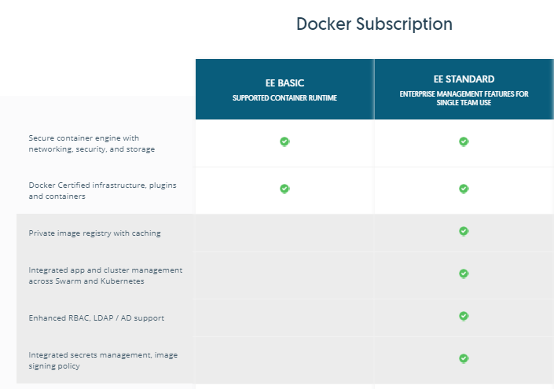
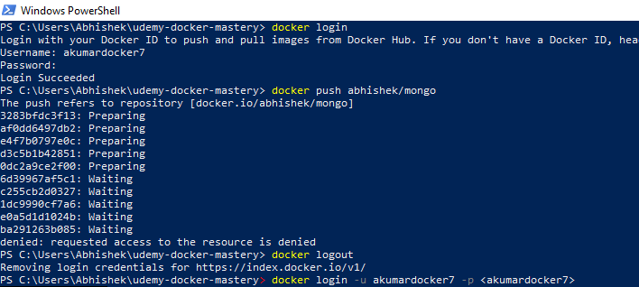
Docker Setup
Docker CE vs Docker EE

Slide 4
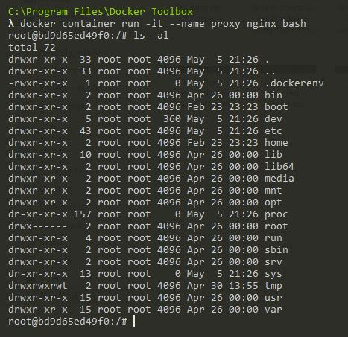
Containers
Image: An application we want to run
Container: A running instance of that image
Many containers running off the same image
As soon as application is dead, container is killed
Some popular docker container commands:
docker container run –it –start new container interactively
docker container exec –it –run additional command in existing container
docker container top <container name> - process list in one container
docker container inspect <container name> -
details of one container config
docker container stats <container name> - performance stats for all containers

Slide 5
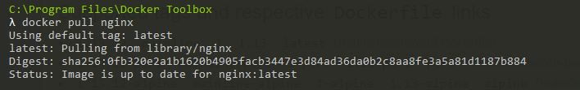
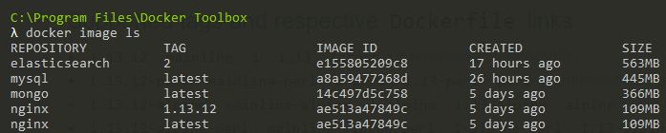
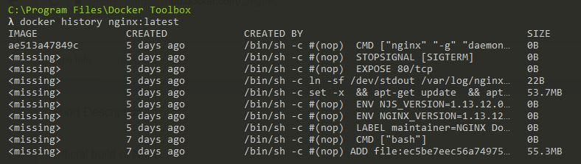
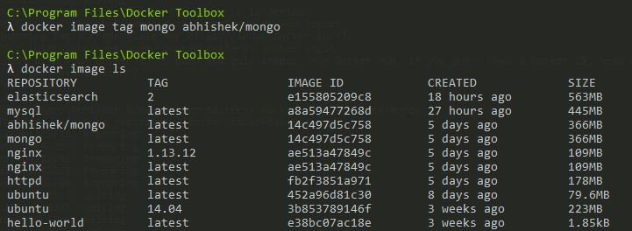
Images
“An image is an ordered collection of root filesystem changes and the corresponding execution parameters for use within a container runtime.”
Images are the building blocks of containers
App binaries and dependencies
Docker Hub: Docker’s default image registry (hub.docker.com)
Some popular docker image commands:
docker image history –shows layers of changes made in an image
docker inspect –returns JSON metadata about the image
docker image tag –assigns one or more tags to an image
docker image push –uploads changed layers to an image registry

Slide 6
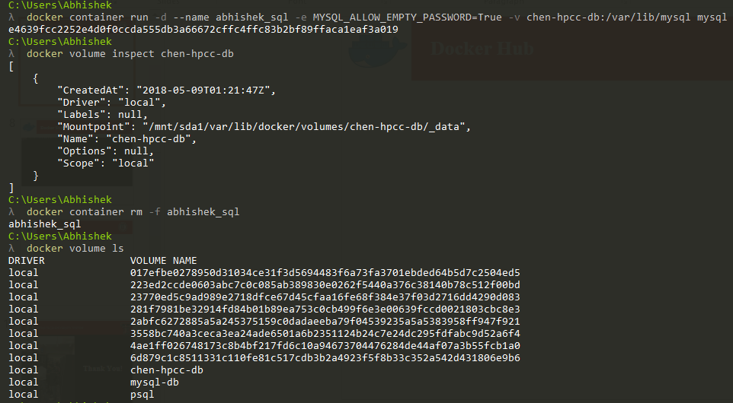
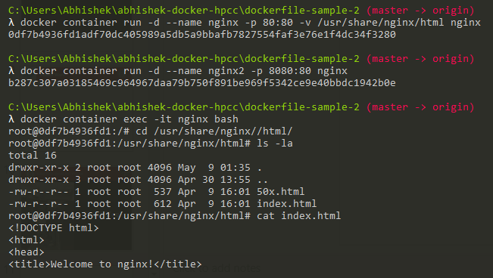
Persistent Data: Volumes and Binds
Containers are immutable and ephemeral
Persistent data – “separation of concerns”
Volumes: Make special location outside of container UFS
Bind Mounts: Link container path to host path

Slide 7
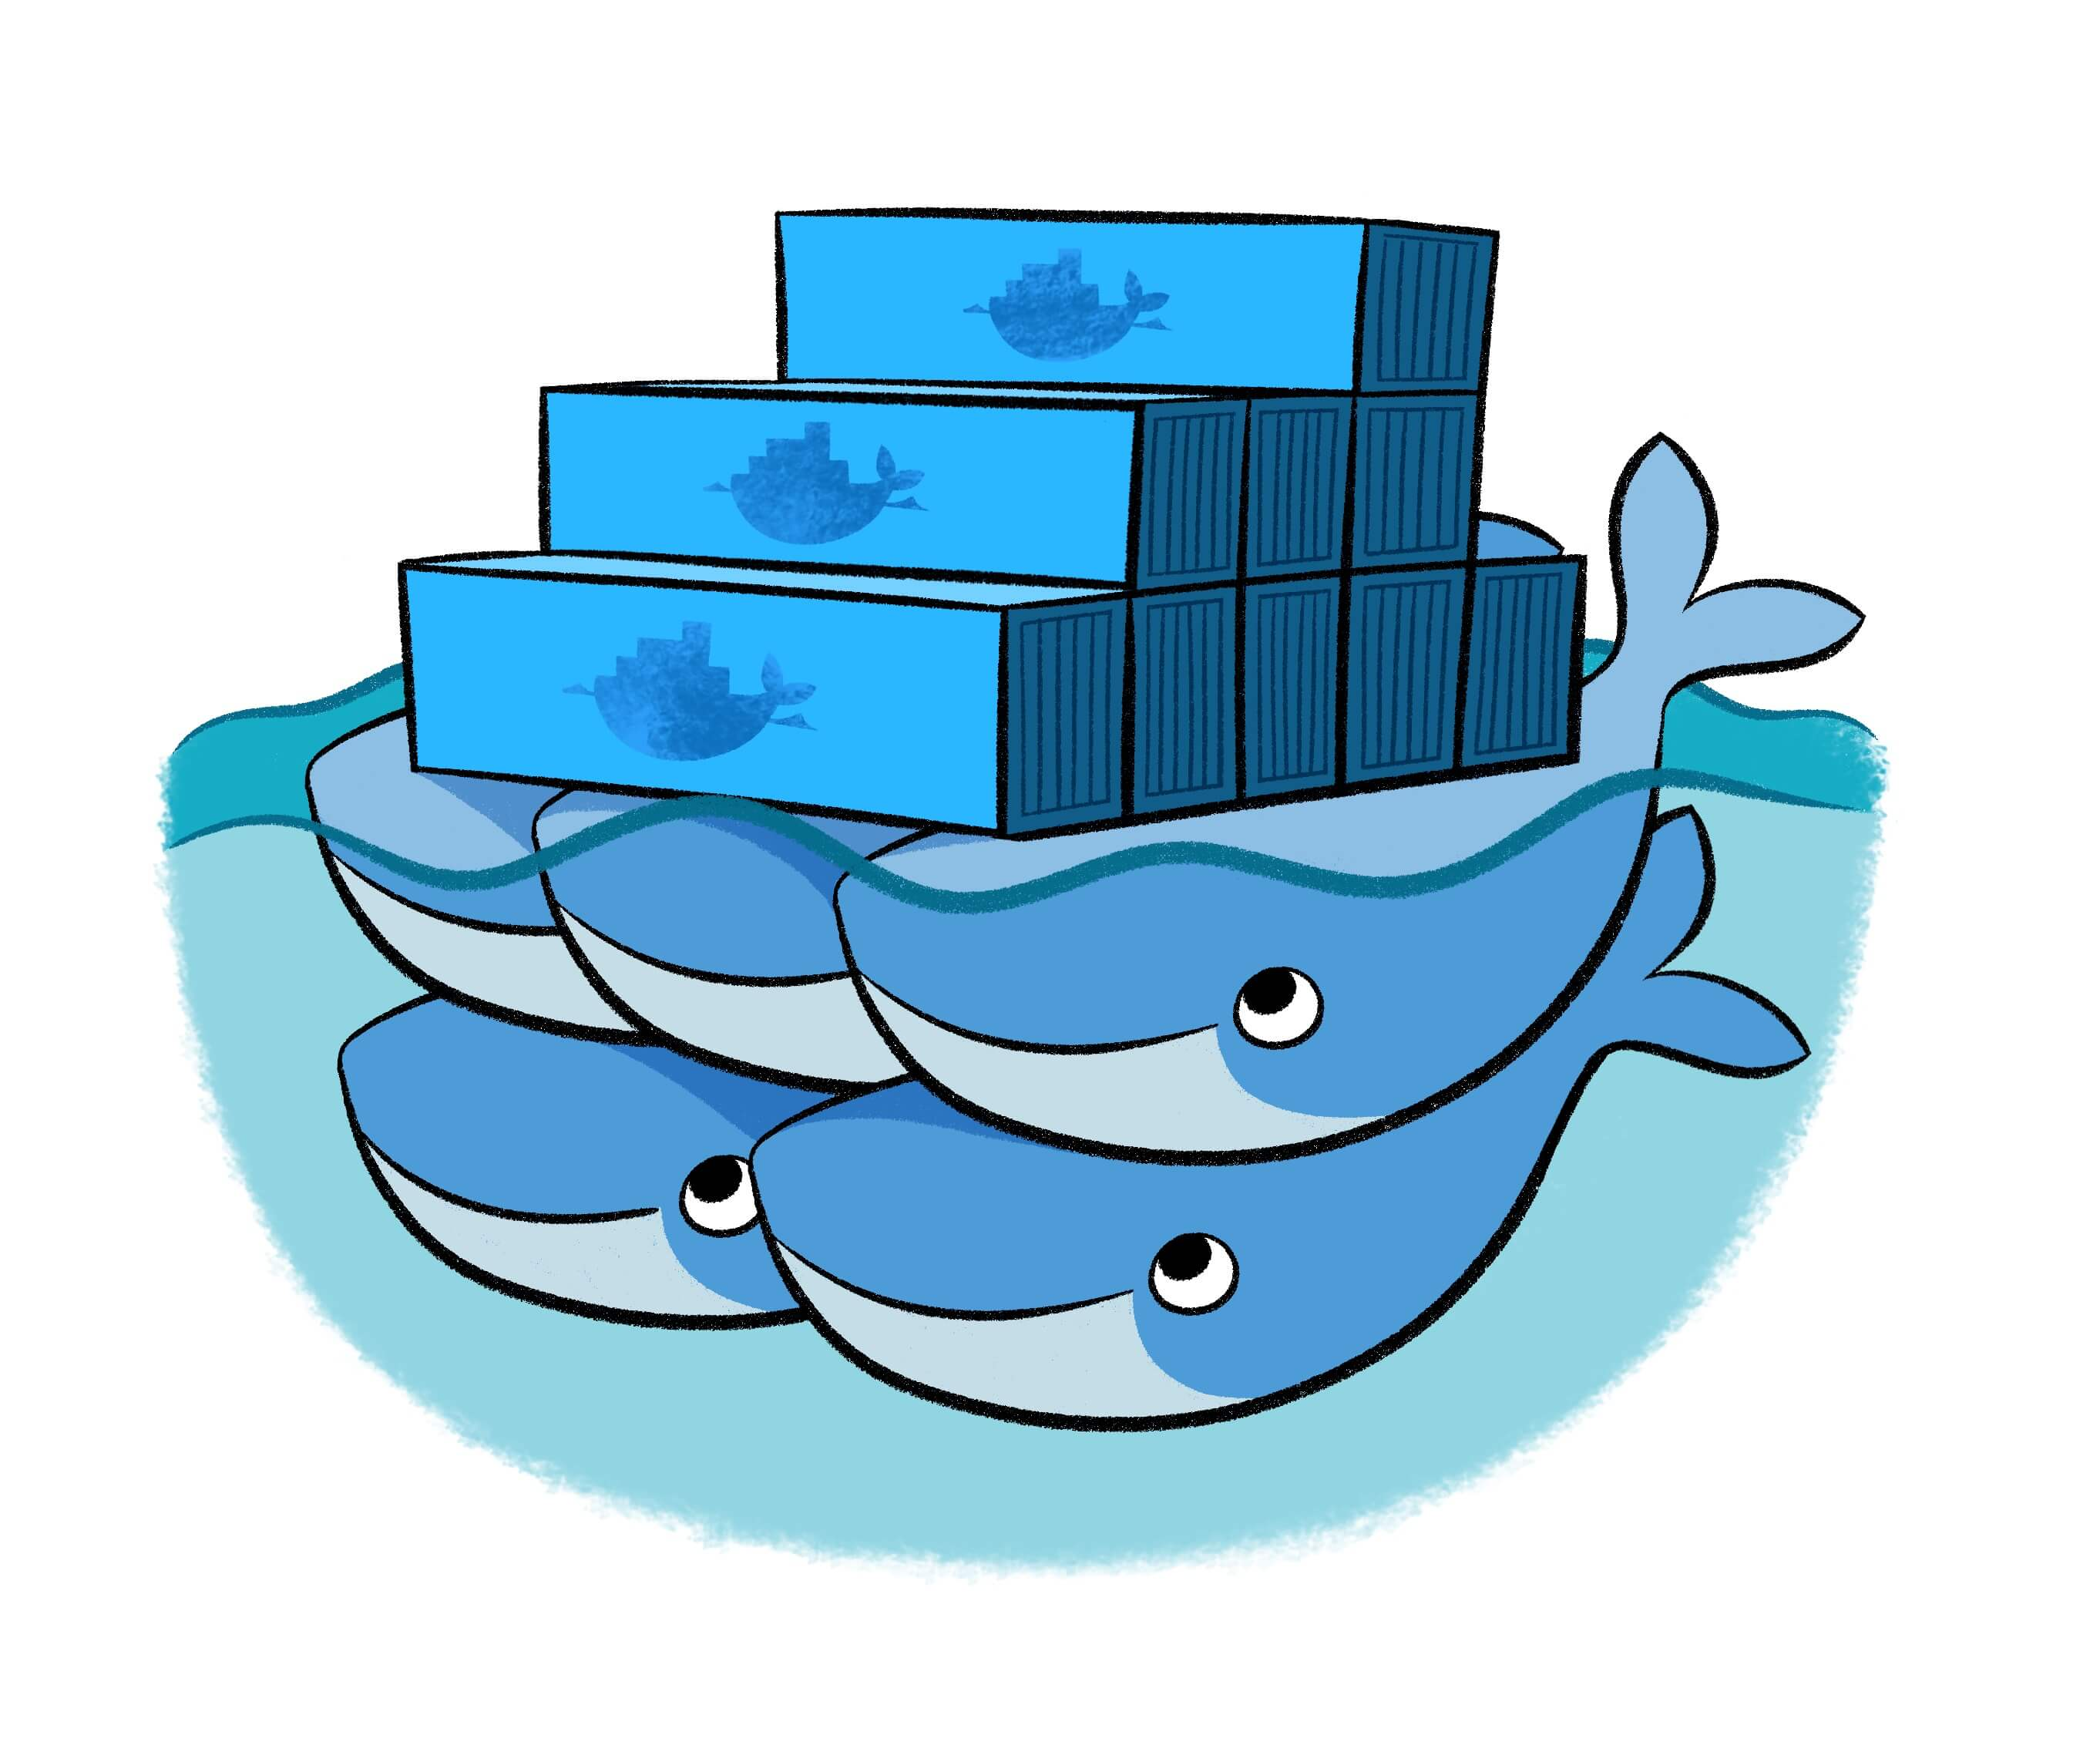
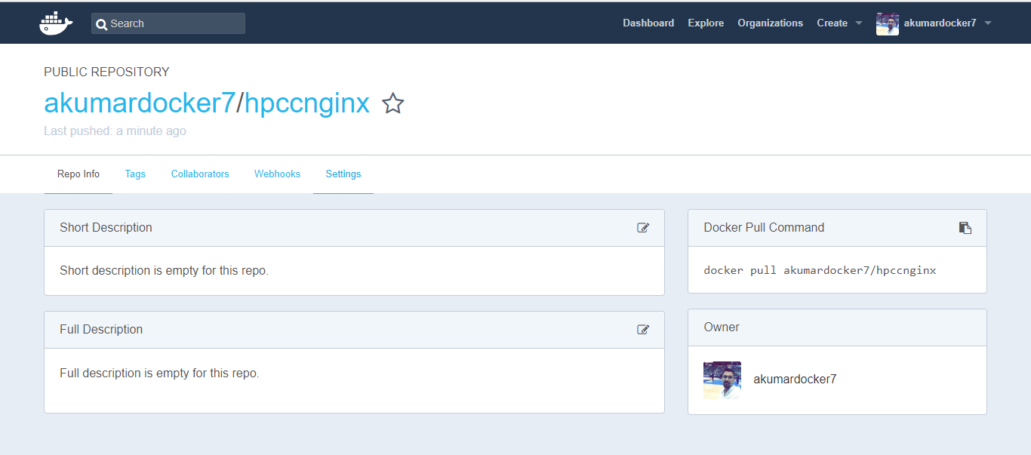
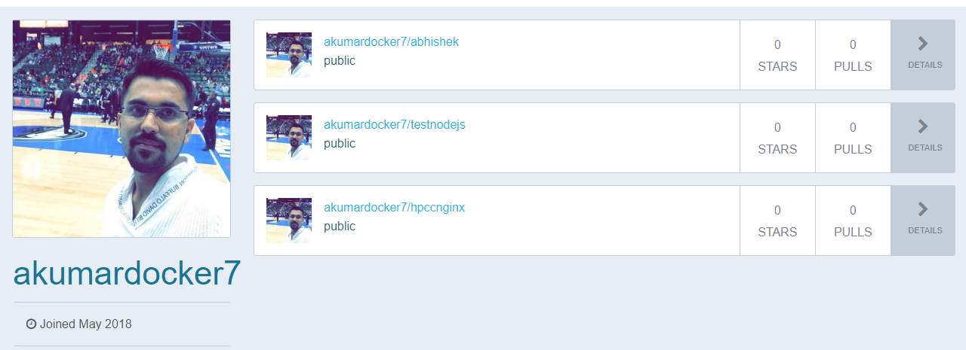
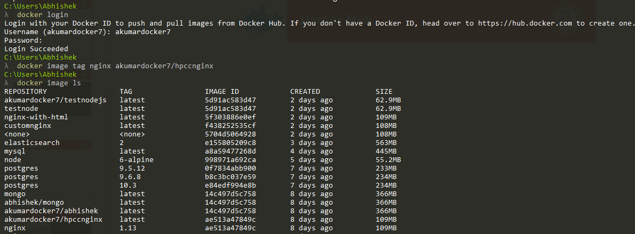
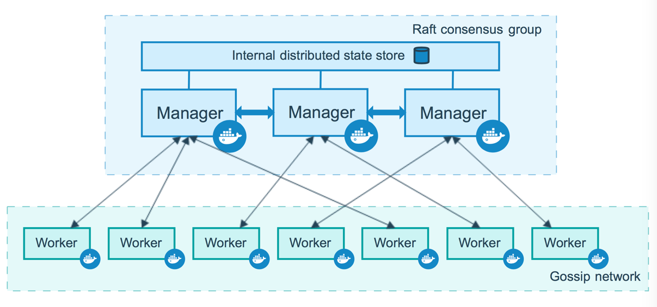
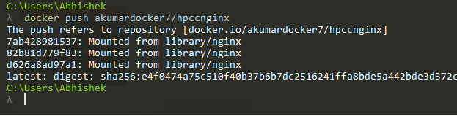
Docker Hub and Docker Swarm
Welcome to my DockerHub!
Working of a Swarm cluster

Slide 8

Multi-node Swarm Cluster
Building a 3- node Swarm cluster using Docker

Slide 9
Example:
Future Work
Build and update Docker images for -
Running a client application on the heading node
Running a server application on each of the agent node
Testing client application against a simulated data center
Client Application (Like RGB)
Python
Alpine Linux
Server Application (Like DMTF/Redfish Mockup Server)
Python
Alpine Linux
Head Node Docker Image
Agent Docker Image
Notes:
RGB= The tool that I am working on that right now, which gets consumed power from the server applications (consumed power of each node), and it returns Energy Efficiency ( It is my current project).

Slide 10


Future Work
Client Application
( like RGB)
Management node
...
Server Application
(Like DMTF/Redfish Mockup Server)
Notes:
RGB= The tool that I am working on that right now, which gets consumed power from the server applications (consumed power of each node), and it returns Energy Efficiency ( It is my current project).

Slide 11

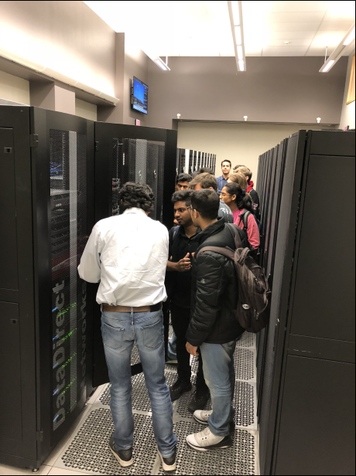
Thank You! CS 5352

